Slide 1
GaianDB Asset Training Day
David Vyvyan,
Paul Stone,
Patrick Dantressangle
Core Features (v1.5 and later)
IBM Confidential

Slide 2
Core Gaian Features
Automatic Node Discovery
  Gaian Nodes will discover and connect to other nodes to form a network.
Data Source Federation
  Data sources available to one node can be accessed by all in the network.
Query Propagation
  Data is stored where it is gathered, queries are automatically propagated to nodes to fetch data when needed.
Query Types
  GaianTable & GaianQuery commands offer different querying options.

Slide 3
Automatic Node Discovery
Unit Objectives
After completing this unit you should be able to:
Understand the principle of automatic connection, based on configuration
Describe the discovery process by which a new Gaian Node joins a network
  Fitness Functions
Understand the strategy of Preferential Attachment and the consequences of this strategy
Understand the use of Computing With Time to align the physical and logical networks.

Slide 4
Automatic Connection Discovery
Default Behaviour – Multicast - log from running a new node
launchGaianServer.bat -p 6417 -log MORE
Log File - gaiandb6417.log shows:
java version "1.6.0"
...
NODE ID: PDST61p:6417
WORKING DIRECTORY: C:\GAIANDB
DERBY SERVER PORT: 6417
PROVENANCE HOST(S): 0.0.0.0
PHYSICAL DATABASE: gaiandb6417
CONFIG FILE: gaiandb_config.properties
…
2012-09-03 15:00:16.812~168471970 GaianNode -------------> Log level set to: MORE
…
2012-… GaianNodeSeeker -------> Entering discovery loop, my details are: PDST61p:6417 gaiandb <pwd>
2012-… GaianNodeSeeker -------> Joining multicast group: /230.255.255.255 on interfaces: [/9.20.225.106]
2012-… GaianNodeSeeker -------> Sending msg: REQ PDST61p:6417 127.255.255.255 ACCESS_CLUSTERS='ClusterPDS', destination: /127.255.255.255
2012-… GaianNodeSeeker -------> Awaiting msg from network [connections sought: 2]...
2012-… GaianNodeSeeker -------> ACK from PDST61p:6416, My ACKs are: {}
2012-… GaianNodeSeeker -------> *******
========================================================================================================================================================================
OUTBOUND connection C0 established: -> PDST61p:6416
....
2012-… GaianNodeSeeker -------> Awaiting msg from network [connections sought: 1]...
2012-… GaianNodeSeeker -------> ACK from PDST61p, My ACKs are: {}
2012-… GaianDBConfig ------------------------> New Discovered Node: PDST61p - Creating associated Gaian Connection: C1
2012-… GaianNodeSeeker -------> *******
========================================================================================================================================================================
OUTBOUND connection C1 established: -> PDST61p
....
Notes:
If we start a new node in the network, we can look at its log and see what has happened

Slide 5
Automatic Connection Discovery
Default Behaviour - Multicast
A Gaian Node will attempt to discover other nodes using a specific multicast group (230.255.255.255 unless specified):
The node will broadcast a Join Request message to the multicast group.
Nodes already in the group (and able to receive the message via multicast) will receive the request and may respond based on the details of the request and a Fitness Function.
The joining node will select a number of responses and connect to those nodes.
The newly started Gaian Node will join the multicast group (and so receive requests from future nodes).
This approach relies on the network infrastructure supporting Multicast routing. If this is not the case, other discovery strategies can be configured:
  Broadcast – nodes will broadcast a join request to a specified broadcast address instead of using multicast.
  Gateways – a known Gaian Node can be specified as a gateway, the gateway node relays join requests to other nodes that are already in the network.
    Subsequent connections and query traffic don’t have to go via the gateway, only the discovery messages.
Notes:
The Gaian database is designed to require the minimum amount of configuration and management.

Slide 6
Node Discovery Options
Multicast, broadcast and gateway discoveries.
“DISCOVERY_IP” parameter in the gaiandb_config.properties file is the address used to discover other GaianDB nodes:
  Multicast Group address - an address in the range 224.0.0.1 to 239.255.255.255
  Broadcast Mask address: e.g. 255.255.255.255 for all machines in the local domains, or 9.255.255.255 for machines in the local domains with a 9.x.x.x address.
  Use 127.255.255.255 for discovering local nodes only
“DISCOVERY_GATEWAYS” parameter in the gaiandb_config.properties file is a list of IP addresses of gateway nodes which will relay our discovery request.
Notes:
You can define different discovery protocols to suit the configuration of the network that you run in.

Slide 7
Node Responses and Fitness Functions
Nodes that receive a join request may reply and indicate their “Fitness” to provide a connection.
The Fitness Function can be modified to implement different connection strategies
A preferential attachment strategy is applied as the default:
  Each nodes fitness function indicates the number of connections that it currently supports.
  New nodes are more likely to connect to nodes with more connections.
The connection strategy is randomised, but biased towards node with more connections.
What actually happens is that each responding node delays for a randomised period of time, inversely proportional to its number of connections before responding with a reply.
  The joining node connects to the first replies that it receives.
This Computing with time approach also helps to align the physical and logical networks. Nodes which are “closer” in terms of network hops, or on faster networks will respond quicker, and so be more likely to be connected.
Notes:
Now we look at what happens when a node receives the discovery request.
The clever part of the network strategy comes in the nature of the response from the existing network nodes.

Slide 8
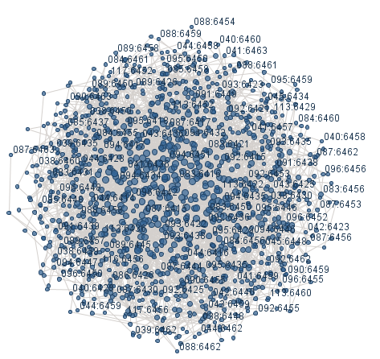
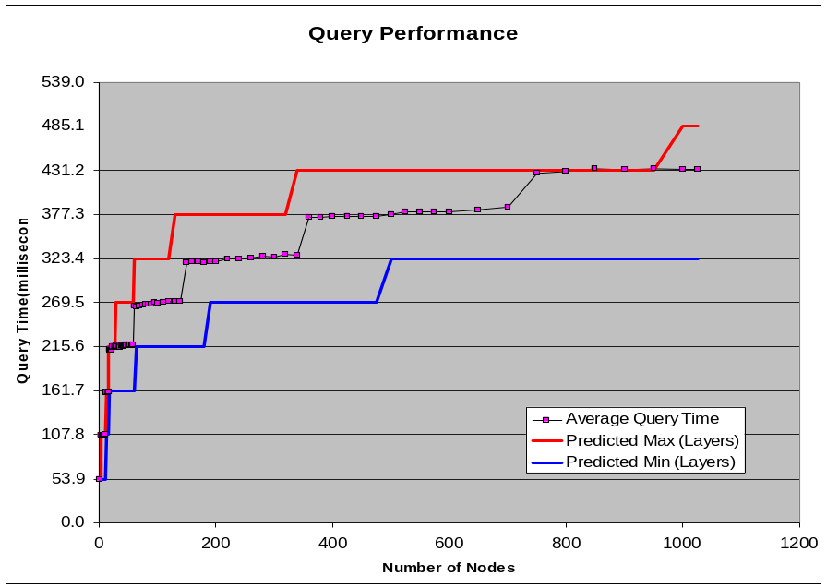
Scale Free Networks
Scale Free networks provide efficient communication of queries and data
The preferential attachment connection strategy was chosen as it has been shown to result in a scale-free network topology.
Scale free networks are “Small World” networks, and have a small distance between the nodes. This will reduce the network communication required to relay queries and the resulting data.
As the network grows, the diameter of the network grows logarithmically (slowly):
Notes:
Talk about scale free graphs, small world networks are shown to have small diameters.
The Gaian discovery and connection protocol (preferential attachment, compute with time etc) was designed and implemented to achieve this scale-free, small world network

Slide 9
Node Departure
Once a node joins the network, it periodically checks that its connections are still valid
  The node attempts a low overhead JDBC call to each of its connected databases.
If a node departs (or we lose connectivity), the remaining nodes may attempt to gain another connection to another node (to satisfy the min connections configuration).
D
E
H
B
F
J
C
A
I
G
Example network, arrows shows which node “requested” the connection, each node has a “min connections” of 2
Notes:
Point out the reconnection strategy:
The animation shows that node G leaves the network (either powers down, or goes out of range).
So the three connections, to F, H and I are no longer valid.
Two of these connections (to F and I) were initiated, requested by the node that disappeared. So when F and I detect that the connections have dropped, no attempt they be made to gain an extra connections: F and I will have fewer connections.
One of these connections (to H) was initially requested by H, so when H detects that the connection has dropped it will re-discover another node to connect to.

Slide 10
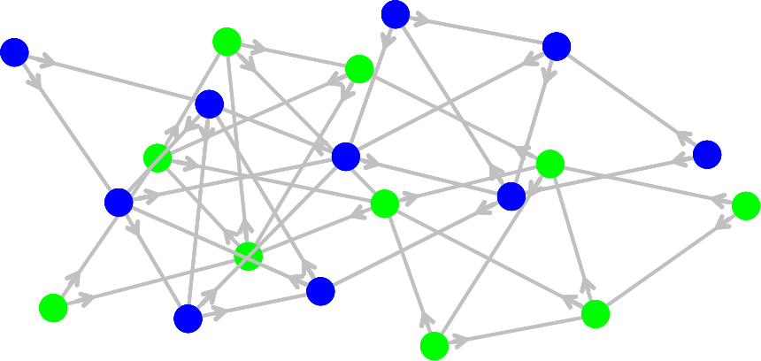
Controlling connectivity
We have a number of additional options to control node connectivity
Access Clusters define subgroups
of nodes in the same physical network,
which will only connect to nodes in the
same cluster:
Permitted Hosts – give a list of host machines from which connections are permitted
Denied Hosts – give a list of host machines from which connections are not permitted
Minimum Connections specifies the number of connections that each node will request, and actively maintain. This defaults to 2, a larger number would provide a more robust network with a lower diameter
Maximum Connections – specifies the maximum number of connections that a node can maintain. If a node has the maximum connections, it will no longer respond to join requests from new nodes. This avoids overloading the hub nodes. This defaults to 10.
Two separate Access Clusters of nodes
Notes:
Min connections – 2 is a good number, resulting in a robust network, “1” tends to result in a fragmented network.

Slide 11
Configuration options
The following parameters can be set in the configuration file
ACCESS_CLUSTERS Use this variable to define a comma-separated list of private IDs identifying private clusters which this GaianDB node belongs to.
ACCESS_HOSTS_PERMITTED Use this variable to define a comma-separated list of hosts which this GaianDB node will accept connections to and process queries from.
ACCESS_HOSTS_DENIED Use this variable to define a comma-separated list of hosts which this GaianDB node will refuse to connect to and will not process queries from.
DISCOVERY_PORT (default: 7777) The port used to perform autonomic GaianDB node discovery.
DISCOVERY_IP (default: 230.255.255.255) Use this variable to define a broadcast mask or multicast group address used to discover other reachable GaianDB nodes.
MULTICAST_INTERFACES This property only applies if DISCOVERY_IP designates a Multicast address, and it identifies the interfaces over which multicast discovery will be performed.
DISCOVERY_GATEWAYS A comma separated list of IP addresses, each of which identifies the host of a GaianDB node which we want to use as a Discovery Gateway to discover other nodes.
DEFINED_GAIAN_CONNECTIONS Use this variable to define a comma-separated list of identifiers for hard-wired connections to create to other Gaian databases, when these cannot be automatically discovered.
MIN_DISCOVERED_CONNECTIONS (default: 2) The number of connections that each node will request, and actively maintain.
MAX_DISCOVERED_CONNECTIONS (default: 10) The maximum number of connections that a node can maintain.
Notes:
In general principle, the Gaian Database is produced to require little or no configuration to work out-of-the box.

Slide 12
Automatic Node Discovery
Unit Objectives Recap
Having completed this unit you should be able to:
Understand the principle of automatic connection, based on configuration
Describe the discovery process by which a new Gaian Node joins a network
  Fitness Functions
Understand the strategy of Preferential Attachment and the consequences of this strategy
Understand the use of Computing With Time to align the physical and logical networks.

Slide 13
Core Gaian Features
Automatic Node Discovery
  Gaian Nodes will discover and connect to other nodes to form a network.
Data Source Federation
  Data sources available to one node can be accessed by all in the network.
Query Propagation
  Data is stored where it is gathered, queries are automatically propagated to nodes to fetch data when needed.
Query Types
  GaianTable & GaianQuery commands offer different querying options.

Slide 14
Unit 2 - Data Source Federation
Unit Objectives
After completing this unit you should be able to:
Describe the Store Locally, Access Globally strategy adopted by the Gaian Database
Understand the concept of a Logical Table
Understand the concept of a Data Source at a node and how that is mapped to a logical table definition
List the different types of Data Source.

Slide 15
Store Locally, Access Globally Paradigm
Fundamentally, data is stored where it is gathered, queries are automatically propagated to nodes to fetch data when needed.
Compare this to Publish/Subscribe mechanism where data is sent from where it is gathered to where it may be needed.
Gaian Database | Publish/Subscribe
Better if query rate is infrequent | Better if data is queried often
Better if data is generated frequently | Better if data is generated less frequently
Better if a small subset of the data is required by the queriers | Better if all, or most of the data is used by the subscribers
Better if a query integrity is maintained without the full set of data | Better if critical data needs to survive a nodes absense
Notes:
Contrast the approaches using four main criteria:
Rate at which the data is accessed
Network load in the gaian db is generated when querying, so the more querys there are, the more load there is on the network.
By contrast , once you send out data in pub/sub protocol, it exists on the subscribing nodes and you can query it there as often as you like.
Rate and which data is produced
If data is produced frequently, pub/sub has a higher network load to publish it. It may prove better to take a gaian approach and wait until you need the data before you get it.
Proportion of the data that is used by the data consumer (that can be predicted in advance).
Similar to the data rate, we may not be able to predict in advance of the query which data you will use, so there is an overhead of passing all the data when you will only use a small proportion of it.
If we know that all of a produced data set will be needed and used by the consumers, pub/sub may be better.
Data Criticality
in a dynamic network, nodes come and go, the Gaian Database makes best efforts to get data at the time of the query, but if a node isn’t available gaian may not be able to get a complete set of data.
If getting the complete set of data is critical, a pub/sub approach or some sort of replication/caching may be needed
Envisaged research for Gaian would involve implementing a level of automatic caching/replication to provide a better coverage of data in highly dynamic situations

Slide 16
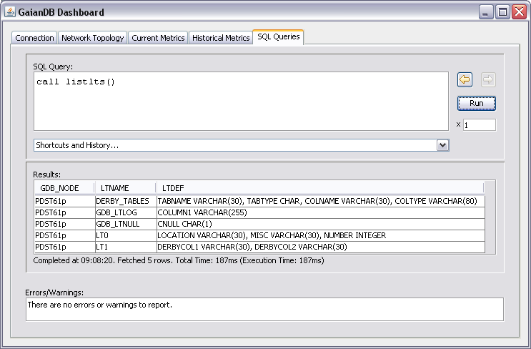
Data Federation - Logical Tables
Logical Tables are the entities that we query in a Gaian Network
E.g. in the Gaian Query “select * from Vehicles”, Vehicles is the name of a Logical Table that must be defined in the Gaian Database configuration.
The columns of data that make up the Logical Table are defined in the Gaian Config.
The Query Call listlts() will show the defined Logical Tables:
GDB_NODE
Where is the table defined
Built in Logical Tables
DERBY_TABLES
GDB_LTLOG
GDB_LTNULL
Other LTs are user-defined
LT0
LT1
LTNAME
The name of the logical table
LTDEF
The definition of the columns of the logical table
Gaian Nodes should share the same definition of a logical table, but there is no automatic synchronization of the LT definitions
  LT definition may be different on different nodes, in which case a node may not return data as expected.

Slide 17
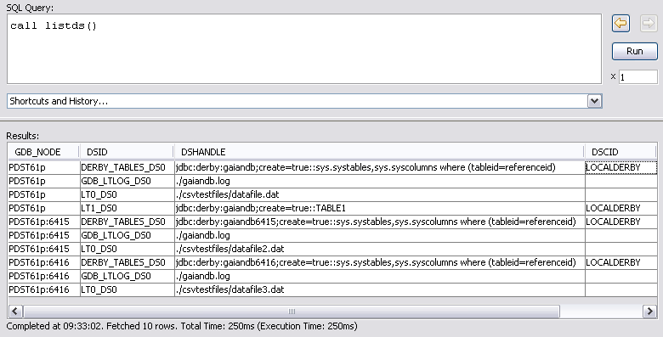
Data Federation - Data Sources
Logical Table data comes from multiple Data Sources
The Logical Table (e.g “Vehicles”) can be mapped by one or more node in the Gaian Database network to one or more Data Sources
call listds() shows the configured data sources in the network:
GDB_NODE
Where is the data source defined
DSID - The name of the data source, prefixed by the logical table name
DSHANDLE
Defines the physical source of the data
DSCID
Identifies the “connection” for a database source
A single node can map a logical table to multiple different data sources, providing federation of those data sources.

Slide 18
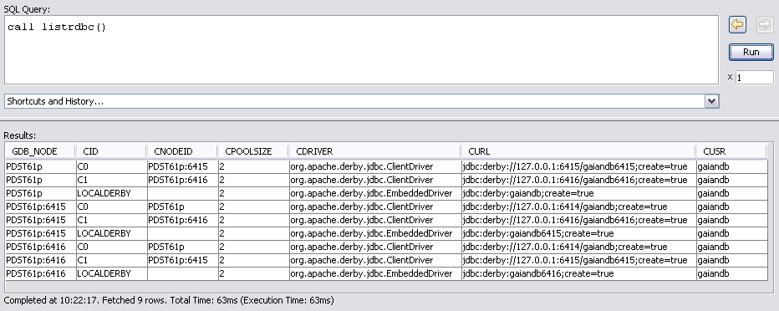
Data Federation - Database Connections
Data Sources which are databases must have a connection configured
call listrdbc() shows the configured database connections on the nodes:
This includes connections to local databases (LOCALDERBY in the example) and also other Gaian Nodes (C0 and C1 on each node in the example).
Notes:
This actually gives a nice introduction to query propagation – when a node is queried, it returns the data from all its configured data sources, which

Slide 19
LT definition in the Configuration File
Logical Table definitions can be seen (and modified) in the config file.
gaiandb_config.properties file:
#--------- Logical table definition
LT0_DEF=ENTITY VARCHAR(30), ID INTEGER
#----------- Data Source 0: file definition ------------
LT0_DS0_VTI=com.ibm.db2j.tools.FileImport
LT0_DS0_FILE=C:/MyFiles/wc_stat.dat
LT0_DS0_C0=COLUMN2
LT0_DS0_C1=COLUMN1
#----------- Data Source 1: DB2 table definition--------
LT0_DS1_CONNECTION=DB2 EMPLOYEE
LT0_DS1_C0=FIRSTNME
LT0_DS1_C1=ID
#----------- DB2 table connection definition--------
DB2_DRIVER=com.ibm.db2.jcc.DB2Driver
DB2_URL=jdbc:db2://localhost:50000/sample
DB2_USR=myuser DB2_PWD=mypasswd
Logical table is called “LT0”. It is defined with two columns “Entity” and “ID”
There are two data sources defined at this node:
  LT0_DS0 which is the file “C:/MyFiles/wc_stat.dat”
  LT0_DS1 which is the EMPLOYEE table in the DB2 database specified.
The query select * from LT0 will return data from both data sources.
A connection is defined to the DB2 database used by LT0_DS1

Slide 20
Supported Data Sources
A Table in a Database
  call setrdbc('db2conn', 'com.ibm.db2.jcc.DB2Driver', 'jdbc:db2://localhost:50000/sample', ‘PaulStone', ‘<password>')
  call setltforrdbtable('db2employee', 'db2conn', 'employee')
The Result of a SQL Expression
  call setltforrdbtable('LT0highmisc', 'localderby', 'lt0 where misc > ''4''')
    The third parameter can be an arbitrary Derby SQL expression.
Text File (CSV formatted, lines in the file are individual records)
  call setltforfile('zzz', './csvtestfiles/datafile3.dat')
Excel Spreadsheet (requires additional “POI” libraries):
  call setltforexcel('lsheet2', 'exceltestfiles/address.xls,Sheet1,A1,D7')
MQTT Messages - A cache of messages received over a message queue (the current release - version 1.5 on alphaworks supports limited functionality)
  Look in the README.html, at “Message Storer” for configuration details
Custom VTIs e.g SPARQL endpoint, ICA REST, Spatial Queries
  Derby’s Virtual Table Interface (VTI) allows implementation and plug in of different data source types.
Notes:
ICA is IBM Content Analytics, has been used to allow searches on a corpus of Natural Language text documents

Slide 21
Optional Data Federation exercise
Please refer to the WorkedExamples.html file in the Gaian Distribution documentation:
  Exercise 1 in the Worked Examples is an exercise to federate a file and database data source to a new Logical Table.

Slide 22
Unit 2 - Data Source Federation
Unit Objectives Recap
Having completed this unit you should be able to:
Describe the Store Locally, Access Globally strategy adopted by the Gaian Database
Understand the concept of a Local Table
Understand the concept of a Data Source at a node and how that is mapped to a logical table definition
List the different types of Data Source.

Slide 23
Core Gaian Features
Automatic Node Discovery
  Gaian Nodes will discover and connect to other nodes to form a network.
Data Source Federation
  Data sources available to one node can be accessed by all in the network.
Query Propagation
  Data is stored where it is gathered, queries are automatically propagated to nodes to fetch data when needed.
Query Types
  GaianTable & GaianQuery commands offer different querying options.

Slide 24
Query Propagation
Unit Objectives
After completing this unit you should be able to:
Describe the mechanism by which a Gaian Database query is propagated between nodes
Be able to use an “Explain” query to determine the route of propagation of a query.
Use the “with_provenance” Query option to determine where data has come from
Use the “Max Depth” option to limit the scope of the query.
Understand how Gaian Queries “Load Balance” around busy nodes

Slide 25
Query Propagation example
Query Propagates from node A through the network of Gaian nodes
D
2
E
2
H
B
1
F
3
2
4
J
1
C
0
3
A
2
I
G
Note that the query is sent across every connection in the network
Depending on latency, the query can sometimes be passed across a connection twice, once in each direction.
Notes:
Here is an example Gaian Network – the lines between nodes show where one node has discovered a connection to another.
- We execute a query on Node A
As well as returning any local data, it initiates the execution of the query on B and C (the nodes that is has a jdbc connection to).
We label these nodes with a number 1 to show that they are one step away from the originating node.
Let’s say that, due to quirks of the network speed, execution order or process scheduling, B recieves the query and processes it first.
B executes the query on C, D, E and F.
D, E and F have not received the query yet so it will be actively processed.
C has already received the query, so the query will not be processed further (hence the dotted line).
Now C executes the query,
it will send to D, E, F and G.
D E and F will most likely be the second query to each of those nodes
G is a new node.
There is a chance that C will also send to B, depending on timing.
C receives the query, does it’s preparatory processing and then at the last moment before it executes against datasources, it checks to see if the query has been received.
Processing is multithreaded so the query from B to C may have been received in a different thread while C is preparing to execute the query.
Now D processes the query and all of the receiving nodes (E and F, possibly, but unlikely C) have already got the query, so it is not propagated furthe from D.
The process continues untill all nodes have processed the message and passed on to their neighbours

Slide 26
Query Propagation example
Query Propagates from node A through the network of Gaian nodes
D
2
E
2
H
B
1
F
3
2
4
J
1
C
0
3
A
2
I
G
The results of the query are relayed back to the original querying node for processing via the “fastest” path of the query.
  Resulting data is “Prefetched” to avoid extra round trips to the remote nodes.
Notes:
Here is an example Gaian Network – the lines between nodes show where one node has discovered a connection to another.
- We execute a query on Node A
As well as returning any local data, it initiates the execution of the query on B and C (the nodes that is has a jdbc connection to).
We label these nodes with a number 1 to show that they are one step away from the originating node.
Let’s say that, due to quirks of the network speed, execution order or process scheduling, B recieves the query and processes it first.
B executes the query on C, D, E and F.
D, E and F have not received the query yet so it will be actively processed.
C has already received the query, so the query will not be processed further (hence the dotted line).
Now C executes the query,
it will send to D, E, F and G.
D E and F will most likely be the second query to each of those nodes
G is a new node.
There is a chance that C will also send to B, depending on timing.
C receives the query, does it’s preparatory processing and then at the last moment before it executes against datasources, it checks to see if the query has been received.
Processing is multithreaded so the query from B to C may have been received in a different thread while C is preparing to execute the query.
Now D processes the query and all of the receiving nodes (E and F, possibly, but unlikely C) have already got the query, so it is not propagated furthe from D.
The process continues untill all nodes

Slide 27
Query Propagation Overview
A query is initially “executed” at one node in the network by a client. The originating node generates a unique Query ID which is included with the query.
  The queryID generated is a combination of the node-name and the time/sequence number:
The node “executes” the query against the known data sources – those locally defined data sources and also the jdbc connections to neighbouring nodes.
Each node receiving a query determines if the query has been received before (using the Query ID).
  If new, it executes the query against it’s local and remote data sources.
    This produces a recursive execution of the query through new nodes in the network
  If a duplicate it (most likely) returns a blank result set.
The results of the query are relayed back to the original querying node for processing via the “fastest” path of the query.
  Resulting data is “Prefetched” to avoid extra round trips to the remote nodes.

Slide 28
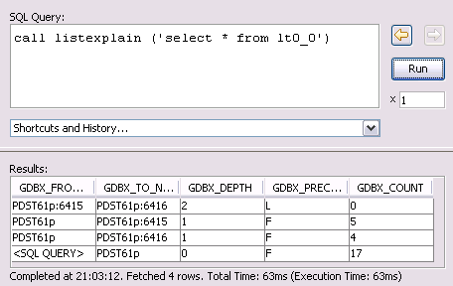
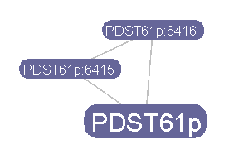
“Explain” tool to see query propagation
The “Explain” function of the Gaian Database can be used to trace how queries propagate in a live running gaian database:
  call listexplain(‘<query>’) – one way to get the explain route
GDBX_DEPTH – the number of propagation steps from the initiating node
Each line shows where the query is propagated between nodes
(here from PDST61p:6415 to PDST61p:6416)
“F” means that the query is the first to reach the node (and is passed on)
“L” means that the query is a later instance (and so stops)
<SQL_QUERY> Shows where the query is initiated (PDST61p here)
GDBX_COUNT – the number of rows of data that would be returned from each step.
Order of results reported from the furthest nodes back to the originating node, so read from the bottom upwards:
  Query is injected at PDS61p (and eventually returns 17 rows of data)
  PDS61p passes the query to PDS61p:6416 and is the first to be received at this node (so it returns 4 rows of data)
  PDS61p also passes the query to PDS61p:6415 and is the first to be received at this node (so it returns 5 rows of data)
  PDS61p:6415 passes the query to PDS61p:6416, it has already been received at this node so returns no data and is passed no further.
4 rows
5
Select * from LT0
17 rows
Notes:
Each node returns a row of data specifying how much data it would fetch from each connected gaian node.

Slide 29
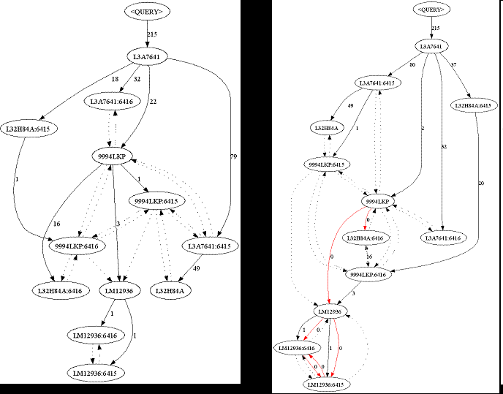
Explain visualization
The “Explain” function can generate a file in a format suitable for visualization:
  Select * from LT0_XF - generates an explain file for table LT0
Then use “graphviz” (http://www.graphviz.org/Download.php) to visualize the query propagation:

Slide 30
Query Propagation Load Balancing
The query propagation mechanism results in automatic load balancing
The exact path taken by a query (and hence the returned data) relies on the latency of the network links, and the delay imposed by the processing nodes.
The same query evaluated for a second time may take a different path than the first time.
Queries will take paths that tend to avoid busy network paths and busy processing nodes. This provides a natural Load Balancing, avoiding bottlenecks in the network:
D
2
E
If F becomes busy, queries to I will reroute through G
If B becomes busy, queries to D, E and F will reroute though C
2
B
1
F
3
2
H
4
J
1
C
0
G
3
A
2
I

Slide 31
Query Propagation Limiting Flood Depth
One query option is Maximum Depth, this limits the number of network hops that a query is passed.
  MaxDepth=0 – query only returns local data from a node.
  MaxDepth=1 – query returns data from a node and it’s direct neighbours.
  MaxDepth=2 – query returns data from a node, direct and two-step neighbours.
    Select * from new com.ibm.db2j.GaianTable ('LT0', 'maxDepth=1') T
  This is achieved by passing a numsteps parameter with the query which is incremented each time the query is relayed. The query is no longer propagated to neighbours when numsteps is equal to the Max Depth of the query.
If a duplicate query is received at a node and the MaxDepth option is set, the query will be propagated if it has a lower numsteps than previous queries.

Slide 32
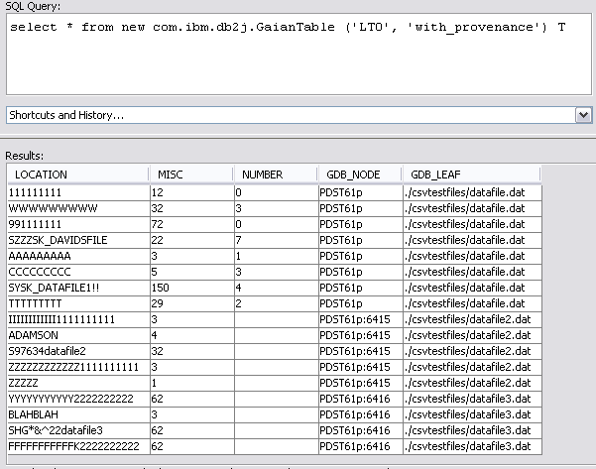
Query Propagation - Where is data from?
One query option “with_provenance” extends the result set to include “provenance” columns to identify the origin of each data row:
Column Name | Description
GDB_NODE | The node name (and port if not the default 6414) of the Gaian Node where the row originated from.
GDB_LEAF | The File name or JDBC URL and DB Table name or the source of the column data.

Slide 33
Query Propagation
Unit Objectives Recap
Having completed this unit you should be able to:
Describe the mechanism by which a Gaian Database query is propagated between nodes
Be able to use an “Explain” query to determine the route of propagation of a query.
Use the “with_provenance” Query option to determine where data has come from
Use the “Max Depth” option to limit the scope of the query.
Understand how Gaian Queries “Load Balance” around busy nodes

Slide 34
Core Gaian Features
Automatic Node Discovery
  Gaian Nodes will discover and connect to other nodes to form a network.
Data Source Federation
  Data sources available to one node can be accessed by all in the network.
Query Propagation
  Data is stored where it is gathered, queries are automatically propagated to nodes to fetch data when needed.
Query Types
  GaianTable & GaianQuery commands offer different querying options.

Slide 35
Query Types
Unit Objectives
After completing this unit you should be able to:
Understand the difference between a GaianQuery and a GaianTable statement
Understand how Views simplify the GaianTable syntax.
Understand how to call built in stored procedures and functions.

Slide 36
GaianTable vs GaianQuery
Both of these “queries” are propagated across the connections of the Gaian Network and can return data from multiple nodes.
A GaianTable statement returns data from a single Logical Table. The logical table may have data sources on every node that the query is propagated to
  Syntax:
  new com.ibm.db2j.GaianTable('<Logical Table Name>'[, '<Logical Table Arguments>‘ ]) <Alias Identifier>
A GaianQuery statement returns data from a specified Subquery. The subquery is executed on every node that the query is propagated to.
  Syntax:
  new com.ibm.db2j.GaianQuery('<Nested SQL Query>'[, '<Logical Table Arguments>'[, '<Nested Query Arguments>']]) <Alias Identifier>
Examples of the use of these two statements follow.

Slide 37
Gaian Table
Gaian Table query – returns results from a single Logical table
  e.g. select * from new com.ibm.db2j.GaianTable('ACCOUNTS', 'with_provenance') T
    “Select *” means that all columns of data are returned.
      Gaian Queries are initially executed in a Derby Relational Database, as such any Derby SQL query is supported.
      In this case, the “is new com.ibm.db2j.GaianTable” definition specifies a java “VTI” class that the derby database executes to get query results.
    ACCOUNTS is the Logical Table Name,
    with_provenance is a Logical Table argument which causes the return of fields indicating which node the data is from.
    T is the alias of the VTI table which may be used to refer to the table results in the overall query (useful when performing joins of multiple tables as shown later)
As we have seen, the data actually comes from the datasources that are mapped to the Logical table, throughout the network of nodes

Slide 38
Gaian Table Aliased by Views
For convenience, GaianDB automatically maintains some system managed views to query a GaianDB logical table.
Instead of
  select * from new com.ibm.db2j.GaianTable(‘PEOPLE') T
We can write
  select * from PEOPLE
For a logical table PEOPLE, the managed views are:
View Name | Description
PEOPLE | Propagated logical table - represents the logical table over all GaianDB nodes
PEOPLE_0 | Just local - represents the logical table on the local GaianDB node only
PEOPLE_1 | Local data and direct neighbours - represents the logical table out to neighbours.
PEOPLE_P | Propagated, with provenance columns
PEOPLE_X | Explain query, shows the route of a query.
PEOPLE_XF | Explain query to the file graph.dot in format suitable to be graphed.
Notes:
Under the covers, each view is mapped as
PEOPLE no arguments
PEOPLE_0
PEOPLE_1
PEOPLE_P
PEOPLE_X
PEOPLE_XF
NB – the aliased view can actually pass more data than necessary as the view does not project the columns, so select name from PEOPLE would still return all columns to the querying node.

Slide 39
Gaian Table Examples of Use
Join queries (combining results from more than one Gaian Table):
  Find information about people and their locations
    select * FROM PERSON P, LOCATION L
    where P.LOCID = L.LOCID
      PERSON is equivalent to new com.ibm.db2j.GaianTable(‘PERSON')
      LOCATION is equivalent to new com.ibm.db2j.GaianTable(‘LOCATION')
  Find pairs of people in the same locations:
    select * FROM PERSON P, PERSON P2
    where P.LOCID = P2.LOCID
V1.5 of the Gaian Database takes a simple approach to evaluating a join: all data which may satisfy the query in any of the specified table is retrieved by the querying node, which then evaluates the join.
ITA research has shown that there are more efficient strategies for performing joins.

Slide 40
Gaian Query Usage
A Gaian Query is invoked with a ‘nested’ subquery. The subquery is executed on every node that the query is propagated to.
  Syntax:
  new com.ibm.db2j.GaianQuery('<Nested SQL Query>'[, '<Logical Table Arguments>'[, '<Nested Query Arguments>']]) <Alias Identifier>
For example:
  select * from new com.ibm.db2j.GaianQuery
  ('select CURRENT_TIMESTAMP TS, LOCATION, MISC from LT0_0', 'with_provenance') Q
  This makes every node query its own local federated sources for LT0 columns LOCATION and MISC and compute its own local timestamp. The provenance columns are added to the results on every node.
Because the subquery is a string parameter to a java function, any strings that it may contain need to be double-quoted e.g:
  select * from new com.ibm.db2j.GaianQuery
  ('select * from new com.ibm.db2j.GaianTable(''LT0'', ''maxDepth=1'') T') Q
Care must be taken not to unintentionally re-propagate a GaianQuery:
  select * from new com.ibm.db2j.GaianQuery
  ('select * from new com.ibm.db2j.GaianTable(''LT0'') T') Q
  This will issue a global query to all node, each node will re-issue a global sub-query.
  If the subclause includes a Logical table or GaianQuery, make sure to specify max_depth=0, unless re-propagation is intended.

Slide 41
Gaian Query Examples
Return the timestamp on each node in the network:
  select * from new com.ibm.db2j.GaianQuery
  ('select * from (values(current_timestamp)) as T(t)', 'with_provenance') Q
Determine the quantity of data at each location (efficiently):
  select * from new com.ibm.db2j.GaianQuery
  ('select count(*) c from LT0_0', 'with_provenance') Q
  Compare this with the following, which is equivalent but less efficient:
  select count(*), GDB_NODE, GDB_LEAF from LT0_p group by GDB_NODE, GDB_LEAF
Efficient Aggregate Functions:
  select max(m) from new com.ibm.db2j.GaianQuery('select max(misc) m from LT0_0') Q
  Compare this with the following, which is equivalent but less efficient:
  select max(misc) from LT0
Pass through create/insert/update/delete/stored procedure calls to distributed nodes
  Create a Derby table of each distributed node:
    select * from new com.ibm.db2j.GaianQuery
    ('create table example(a int)', 'with_provenance') GQ
  Insert data into distributed table on a specific node (T61p:6415 here):
    select * from new com.ibm.db2j.GaianQuery
    ('insert into example values(1), (2), (3)', 'with_provenance') GQ
    where gdb_node='PDST61p:6415'
  Drop distributed tables:
    select * from new com.ibm.db2j.GaianQuery
    ('drop table example','with_provenance') GQ
    where gdb_node='PDST61p:6415'

Slide 42
Gaian Query Examples cont.
Evaluate local functions:
  select * from new com.ibm.db2j.GaianQuery('select * from LT where msg_received > {fn TIMESTAMPADD(SQL_TSI_MINUTE, -10, current_timestamp)}', 'maxDepth=0') GQ
  This queries data sources federated by logical table LT on each node and only gets the data that was generated in the last 10 minutes, relative to local current timestamps
Select data from non-federated tables:
  select * from new com.ibm.db2j.GaianQuery('select jmemorypercent() jmem from sysibm.sysdummy1', 'with_provenance') Q
  select * from new com.ibm.db2j.GaianQuery('select * from table1', 'with_provenance') Q
“Partitioned” Join – data will only be joined with other data from that one node:
  select * from new com.ibm.db2j.GaianQuery('select * from example, lt0
  where example.a = cast(lt0.misc as int)', 'with_provenance') GQ
    This is a partitioned join between “example” and lt0 table
Delegate Query to another node (one which can perform the query more efficiently?)
  select * from new com.ibm.db2j.GaianQuery('select * FROM PERSON PERS, LOCATION LOC
  where PERS.LOCID = LOC.LOCID', 'with_provenance') Q WHERE gdb_node='<BESTNODEID>‘

Slide 43
Stored Procedures and functions
Each Gaian node has a number of built in stored procedures and functions.
  call listspfs() - lists all defined stored procedures and functions
A complete list of procedures is also included in the distributed Readme.html file.
Information procedures
  call listlts() Show logical table definitions in the whole network.
  call listrdbc() Show loaded rdb connections in whole network.
  call listds() Show loaded data sources in whole network.
  call listflood() Show connections/topology traversed by a flood query - with no access to data sources in the network.
  call listconfig() Show all configuration properties and their values.
  call listspfs() Show all stored procedures and functions in schema 'gaiandb'.
  If you want to filter values from these, the calls need to be contained in a GaianQuery. e,.g.
  SELECT * FROM NEW com.ibm.db2j.GaianQuery
  ('call listlts()', 'maxdepth=0') GQ where WHERE LTNAME LIKE 'LT%'
Configuration procedures
  call setconfigproperty(key, value)
  call setloglevel(level) Possible values are: 'NONE', 'LESS', 'MORE', 'ALL'.
  call setlt(ltname, ltdef*, ltconstants*) plus “setlt*”
  call setltforfile(ltname, filename)
  call setdsfile(ltname, dsname, filename, options*, columns*)
User defined Stored Procedures can be easily configured and used to extend the Gaian functionality

Slide 44
Retrieving function values.
The following command gives a list of Functions built in to the Gaian Database:
  select * from new com.ibm.db2j.GaianQuery
  ('call listspfs()', 'maxdepth=0') GQ where ALIASTYPE='F'
    GDB_NODE_CPU () Returns the recent CPU usage of the node
    GDB_QRY_ACTIVITY () Returns the measured query activity of the node
    GDB_THROUGHPUT () Returns the measured data throughput of the node
    GETNODECOUNT () Returns the number of nodes at this moment in the gaian network
    JMEMORY() The amount of java memory currently in use
Built in Derby functions can also be used, see the apache derby documentation
  Syntax note: gaian functions require brackets after their inclusion, built-in functions do not need brackets
Executing a function against local node:
  select gdb_throughput () th, current_timestamp ts from sysibm.sysdummy1
Executing a function against all gaian nodes:
  select * from new com.ibm.db2j.GaianQuery(
  'select * from (values (gdb_throughput(), current_timestamp)) as T(th, ts)', 'with_provenance') Q
Executing a function against specific gaian nodes:
  select * from new com.ibm.db2j.GaianQuery('select * from (values (gdb_throughput(), current_timestamp)) as T(th, ts)', 'with_provenance') Q WHERE gdb_node='<NODEID>'

Slide 45
Query Types
Unit Objectives Recap
Having completed this unit you should be able to:
Understand the difference between a GaianQuery and a GaianTable statement
Understand how Views simplify the GaianTable syntax.
Understand how to call built in stored procedures and functions.

